Slide 1




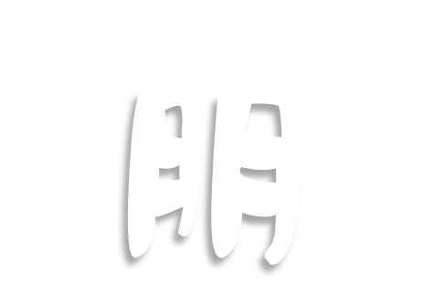


PIN - PeNG

Slide 2


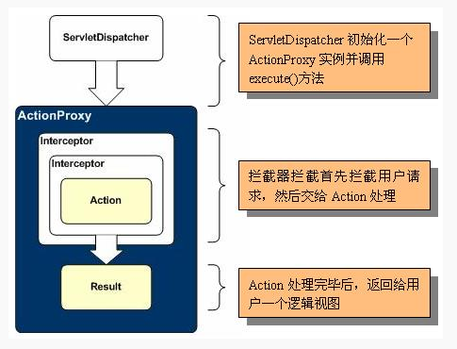

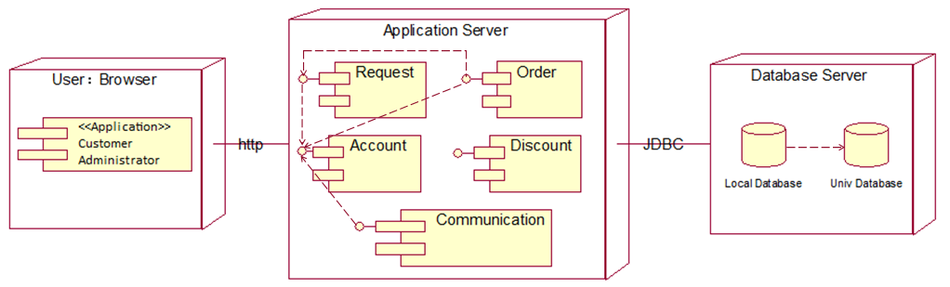
STRUCTURE
Combination：
MVC
STRUTS2
Hibernate3
To reduce the time
Notes:
made a change/Huge Numbers of/Vary in the type & size/times is flush.

Slide 3
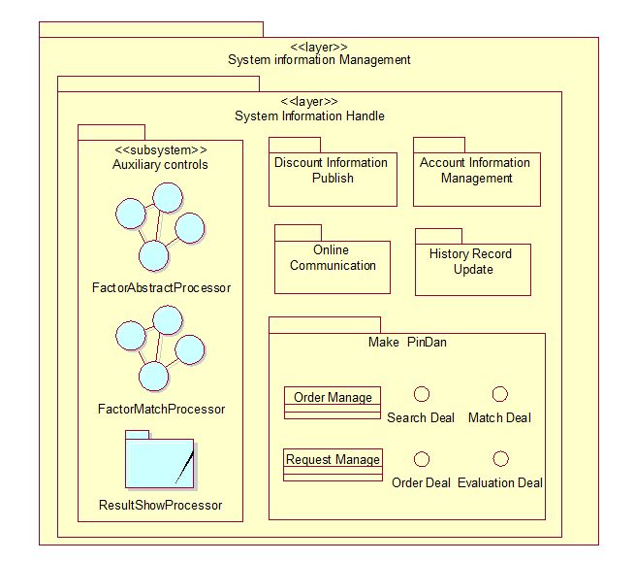
Sub-system structure
Notes:
underload

Slide 4
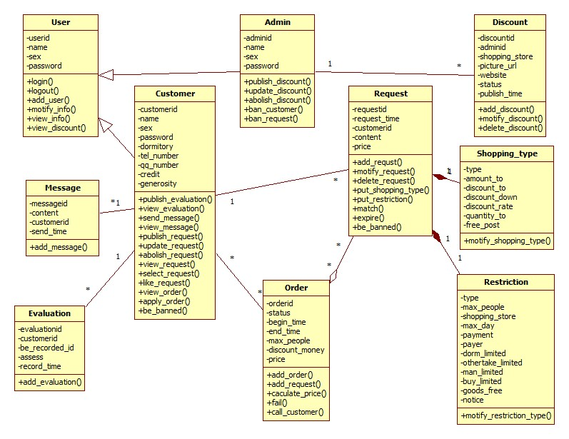
Class diagram
Notes:
underload

Slide 5
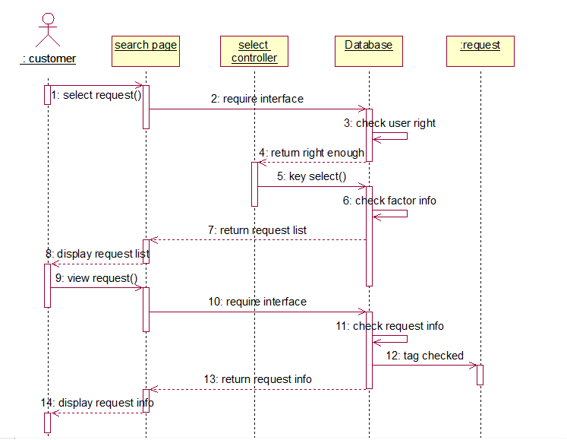
Sequence diagram-search and check
Notes:
underload

Slide 6
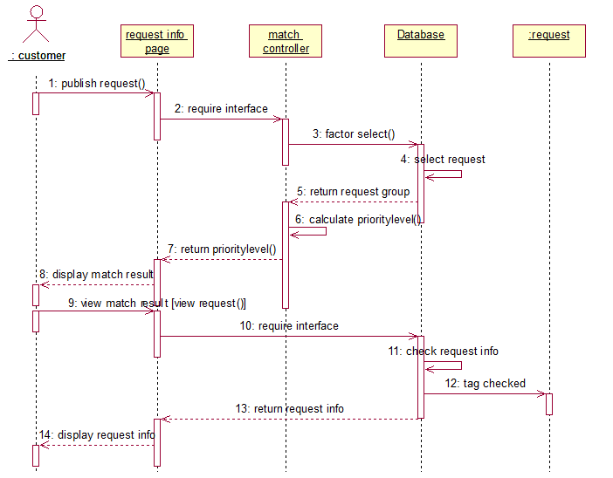
Sequence diagram-match and check
Notes:
underload

Slide 7
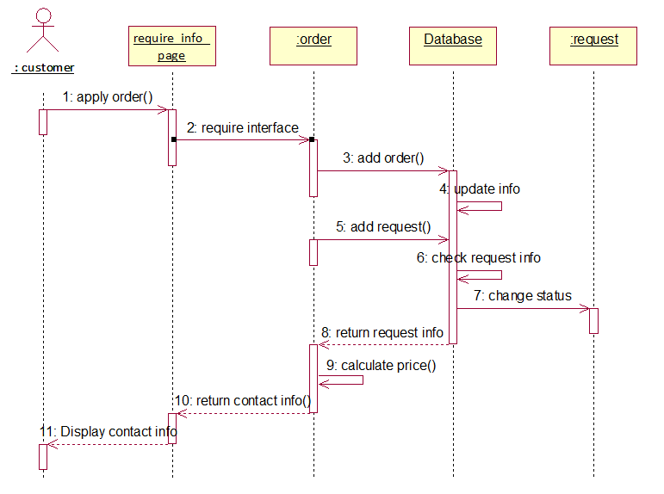
Sequence diagram- apply
Notes:
underload

Slide 8
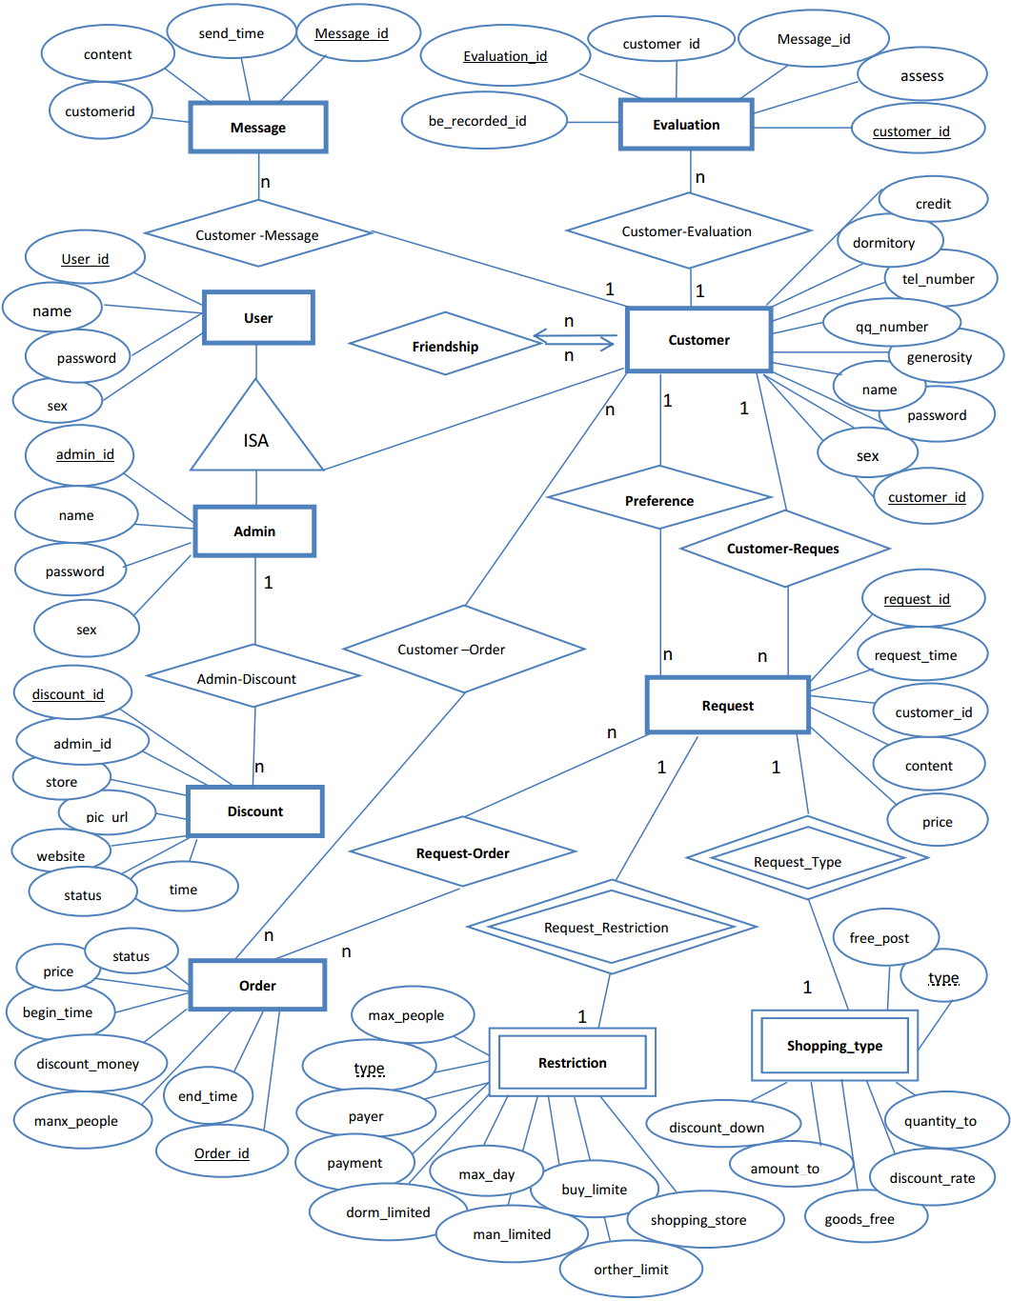
ERD
Notes:
underload

Slide 9
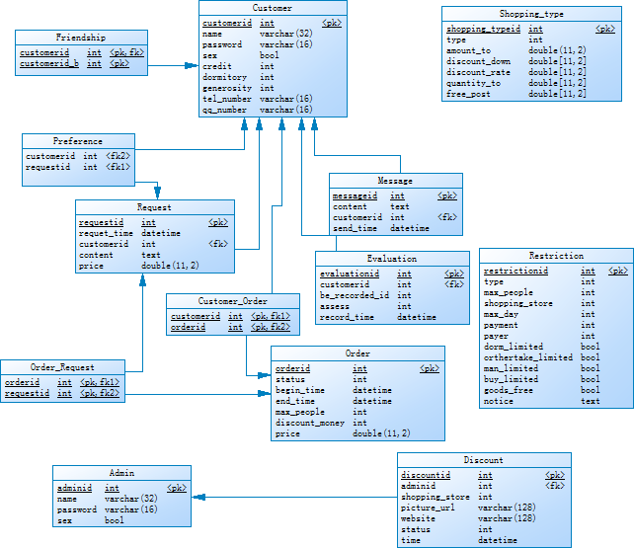
Schema
Notes:
underload

Slide 10
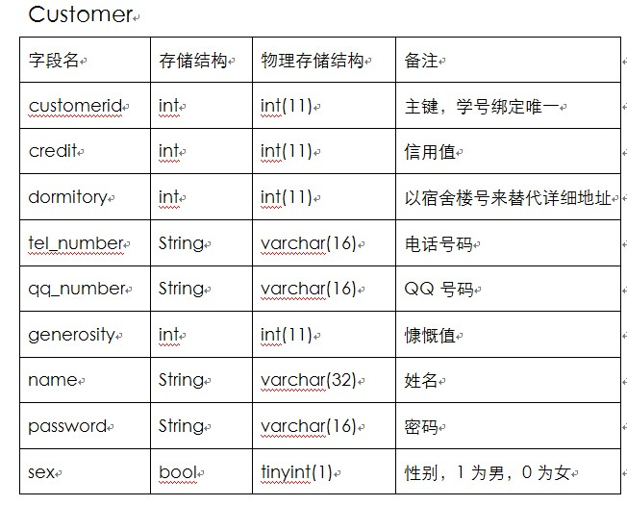
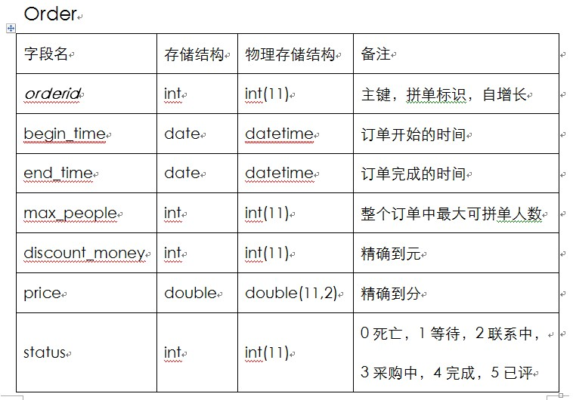
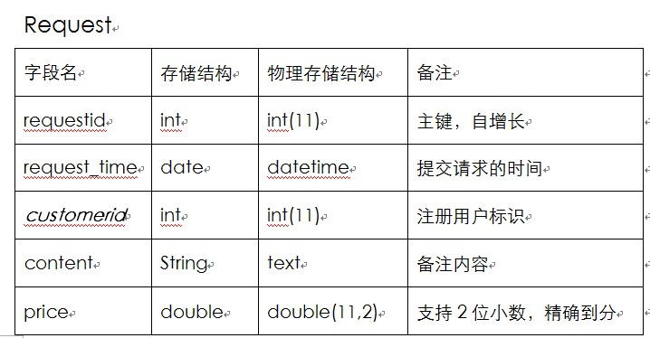
Table
Notes:
underload

Slide 11

UI design
Notes:
underload

Slide 12
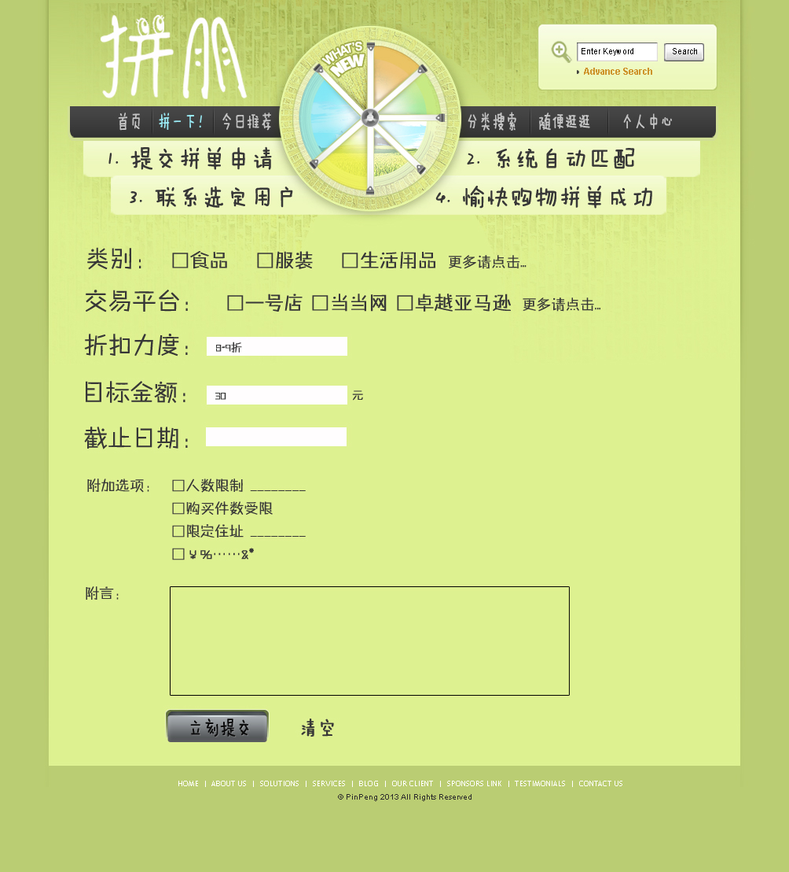
UI design
Notes:
underload

Slide 13
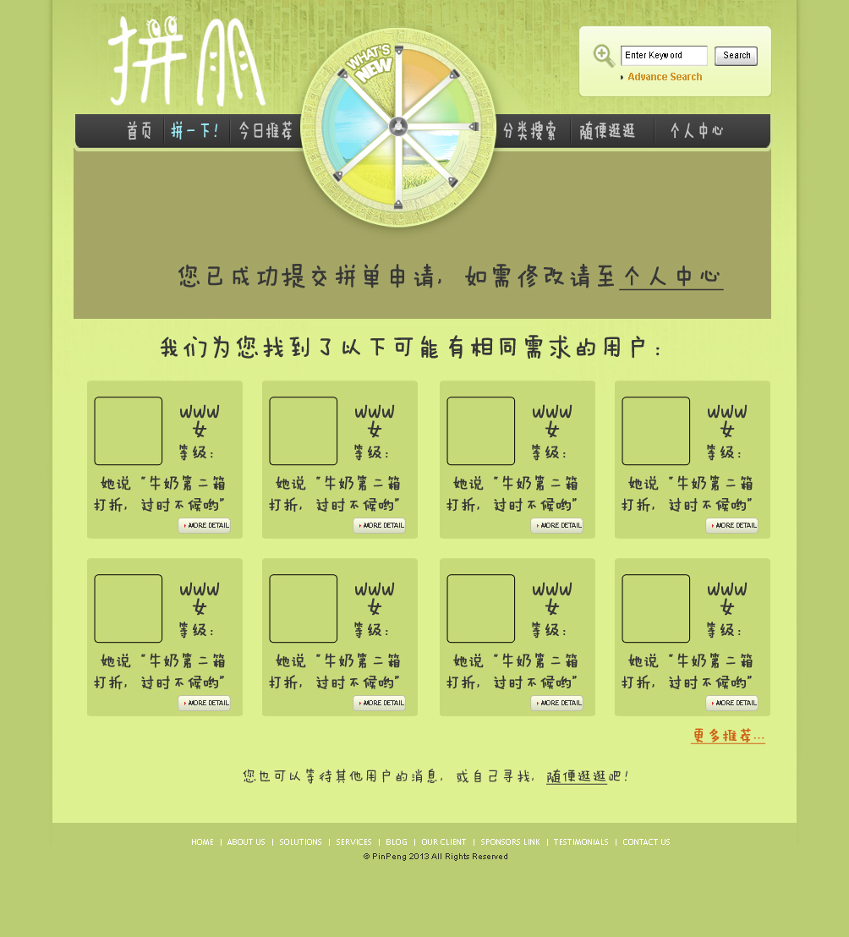
UI design
Notes:
underload

Slide 14
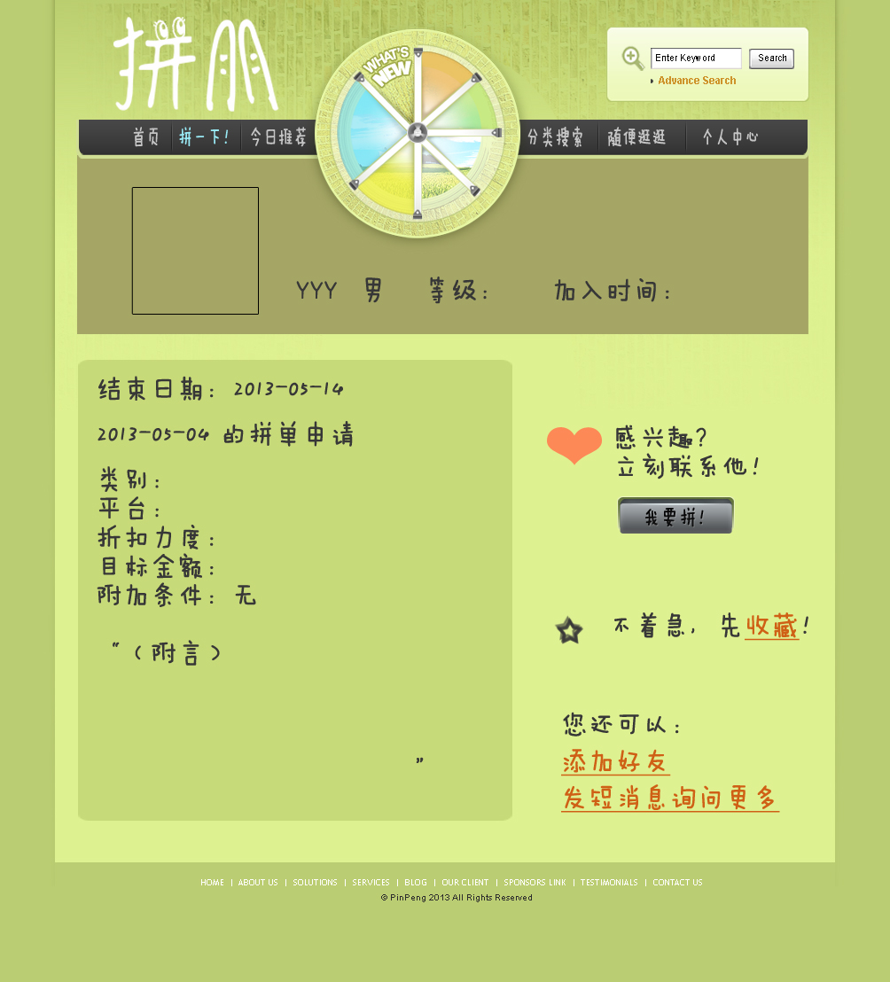
UI design
Notes:
underload

Slide 15
Error handling
Error message：
· wrong username/password input
· wrong input when changing personal info （length/repeat）
· wrong input in the request
· blank
Notes:
made a change/Huge Numbers of/Vary in the type & size/times is flush.

Slide 16
Error handling
Remedy：
· system halted：backup
·power outage：backup
· fail to link to database：check and restart
Notes:
made a change/Huge Numbers of/Vary in the type & size/times is flush.

Slide 17
Error handling
System maintenance design
· person responsible for maintenance must understand the system fully
· can give out the solutions to the general problems
· DBA must backup the data timely and be responsible for system security.
Notes:
made a change/Huge Numbers of/Vary in the type & size/times is flush.

Slide 18
Thank
you

